Slide 1
MATLAB Bioinformatics Toolbox

Slide 2
Genome and Proteome Analysis Using MATLAB Bioinformatics Toolbox
Connecting to Web accessible databases
• Reading and converting between multiple data formats
• Determining statistical characteristics of data
• Manipulating and aligning sequences
• Modeling patterns in biological sequences using Hidden Markov Model (HMM) profiles
• Reading, normalizing, and visualizing microarray data
• Creating and manipulating phylogenetic tree data
• Interfacing with other bioinformatic software (BioPearl and BioJava)

Slide 3
Web-Based Databases
You can directly access public databases on the Web and copy sequence and gene expression information into MATLAB.
Currently supported sequence databases are GenBank (getgenbank), GenPept(getgenpept), European Molecular Biology Laboratory EMBL (getembl),Protein Sequence Database PIR-PSD (getpir), and Protein Data Bank PDB(getpdb). You can also access data from the NCBI Gene Expression Omnibus(GEO) web site by using a single function (getgeodata).

Slide 4
Connecting to Web Accessible Databases
1 Use the MATLAB Help browser to explore the Web. In the MATLAB Command Window, type
web('http://www.ncbi.nlm.nih.gov/’)
A separate browser window opens with the home page for the NCBI Web site
2 Search the NCBI Web site for information. For example, to search for the human mitochondrion genome, from the Search list, select Genome, and in the for box, enter mitochondrion homo sapiens.
The NCBI Web search returns a list of links to relevant pages.
Get sequence information from a Web database. For example, to get sequence information for the human mitochondrial genome, in the MATLAB Command Window, type
mitochondria = getgenbank('NC_012920.1','SequenceOnly',true)

Slide 5
Sequence Statistics
After sequencing a piece of DNA, one of the first tasks is to investigate the nucleotide content in the sequence, i.e., to determine mono-, di-, and trinucleotide content, and to locate open reading frames.
aacount, basecount, codoncount, dimercount, nmercount, ntdensity
search for specific patterns within a sequence
(seqshowwords, seqwordcount),
or search for open reading frames (seqshoworfs).
In addition, you can create random sequences for test cases (randseq)

Slide 6
Determining Nucleotide Content
Example : Studying the human mitochondrial genome. While many genes that code for mitochondrial proteins are found in the cell nucleus, the mitochondrial has genes that code for proteins used to produce energy.

Slide 7
Determining Nucleotide Content
1 Plot monomer densities and combined monomer densities in a graph. In the MATLAB Command window, type
ntdensity(mitochondria)
This graph shows that the genome is A+T rich.
2 Count the nucleotides using the function basecount.
basecount(mitochondria)
3 Count the nucleotides in the reverse complement of a sequence using the function seqrcomplement.
basecount(seqrcomplement(mitochondria))
4 Use the function basecount with the chart option to visualize the nucleotide distribution.
basecount(mitochondria,'chart','pie’);
MATLAB draws a pie chart in a figure window.
5 Count the dimers in a sequence and display the information in a bar chart.
dimercount(mitochondria,'chart','bar’)
MATLAB lists the dimer counts and draws a bar chart.

Slide 8
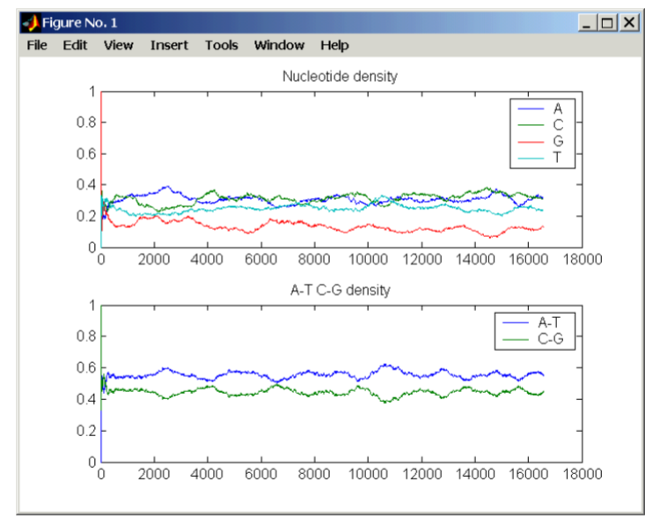
ntdensity(mitochondria)

Slide 9
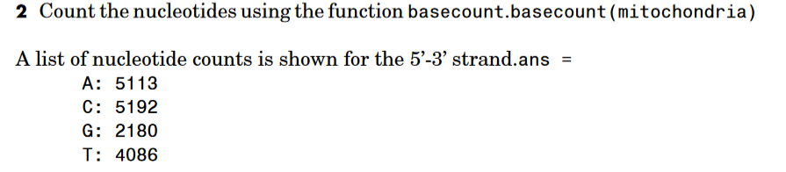
basecount(mitochondria)

Slide 10
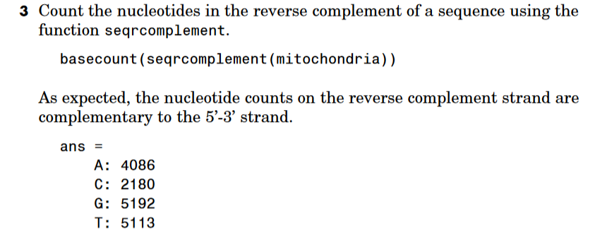
basecount(seqrcomplement(mitochondria))

Slide 11
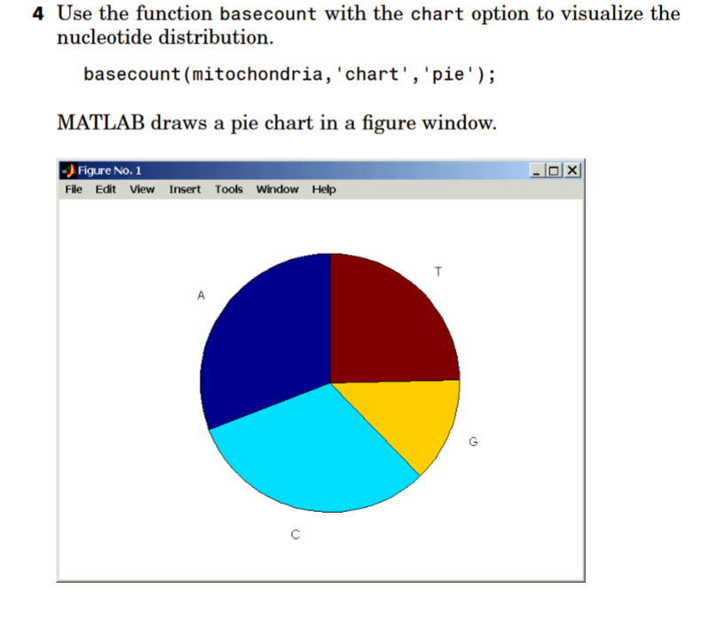
basecount(mitochondria,'chart','pie’);

Slide 12
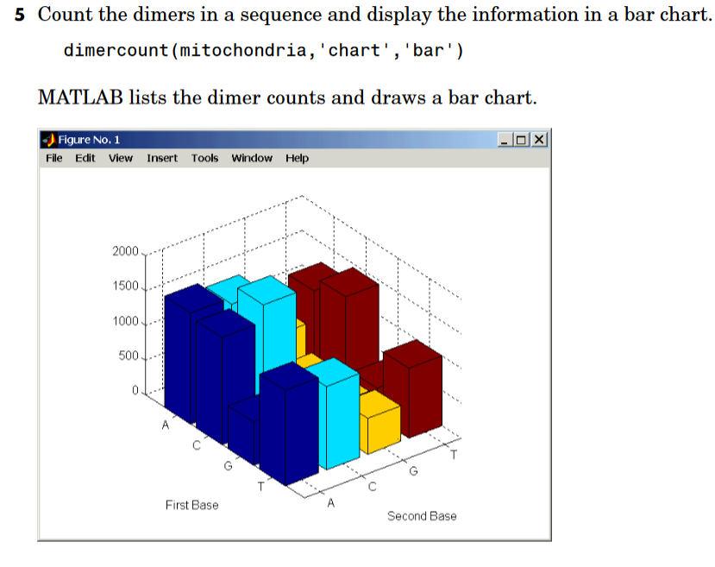
dimercount(mitochondria,'chart','bar’)

Slide 13
Determining Codon Composition
Trinucleotides (codon) code for an amino acid, and there are 64 possible codons in a nucleotide sequence. Knowing the percent of codons in your sequence can be helpful when you are comparing with tables for expected codon usage.
1 Count codons in a nucleotide sequence. In the MATLAB Command Window, type
codoncount(mitochondria)
MATLAB displays the codon counts for the first reading frame

Slide 14
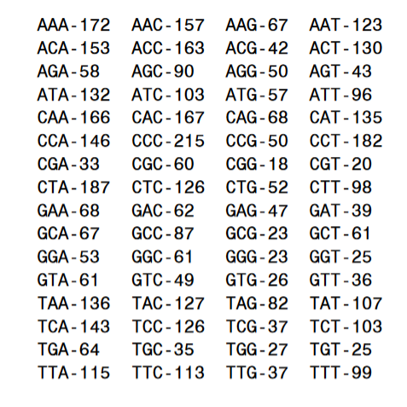
codoncount(mitochondria)

Slide 15
Determining Codon Composition
2 Count the codons in all six reading frames and plot the results in a heat map.
for frame = 1:3
figure('color',[1 1 1])
subplot(2,1,1);
codoncount(mitochondria,'frame',frame,'figure',true);
title(sprintf('Codons for frame %d',frame));
subplot(2,1,2);
codoncount(mitochondria,'reverse',true, 'frame',frame, 'figure',true); title(sprintf('Codons for reverse frame %d',frame));
end
MATLAB draws heat maps to visualize all 64 codons in the six reading frames

Slide 16
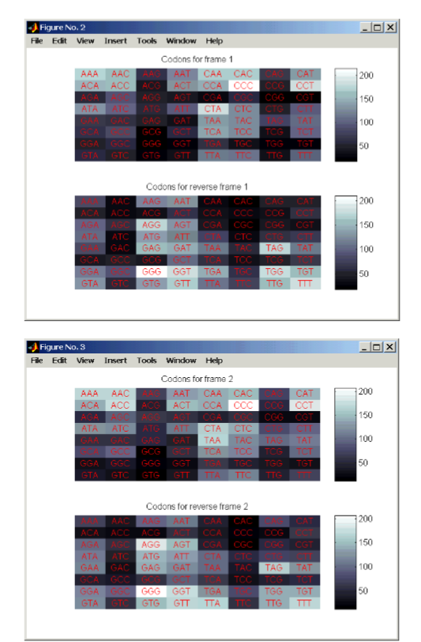
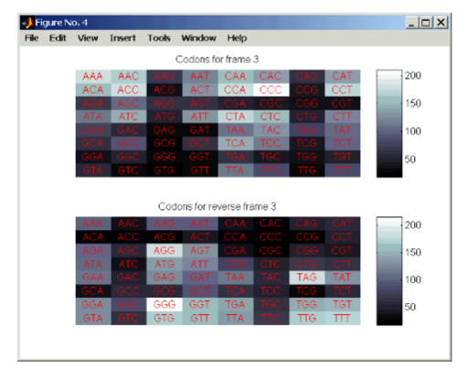

Slide 17
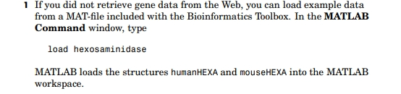
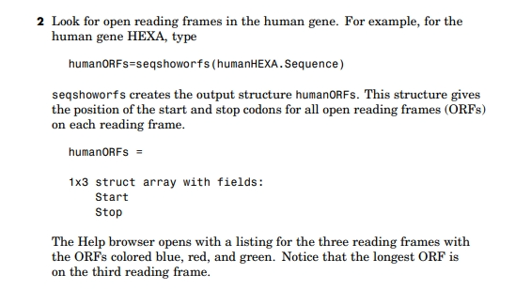

Slide 18
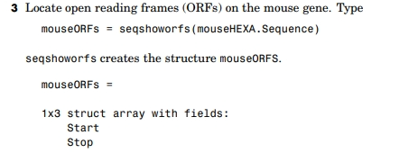

Slide 19
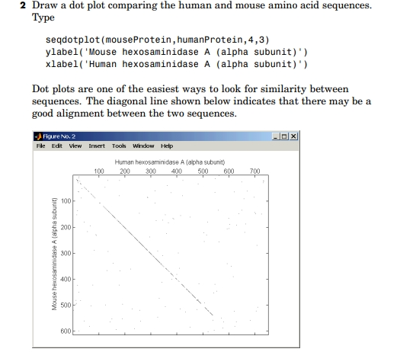

Slide 20
Sequence Manipulation
The toolbox provides routines for common operations such as converting DNA or RNA sequences to amino acid sequences that are basic to working with nucleic acid or protein sequences
aa2int | aa2nt | dna2rna | rna2dna | int2aa
int2nt | nt2aa | nt2int | seqcomplement | seqrcomplement seqreverse

Slide 21
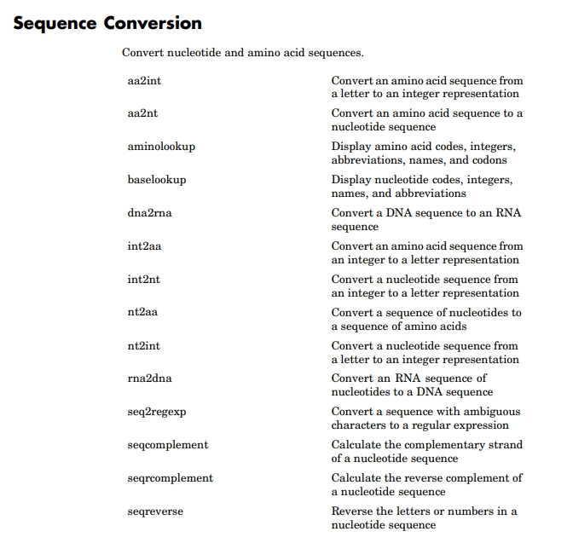
Sequence Conversion

Slide 22
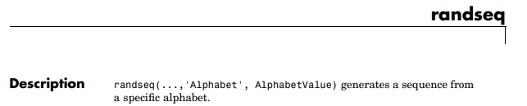
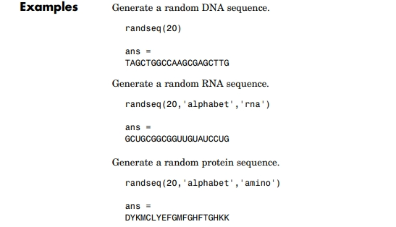

Slide 23
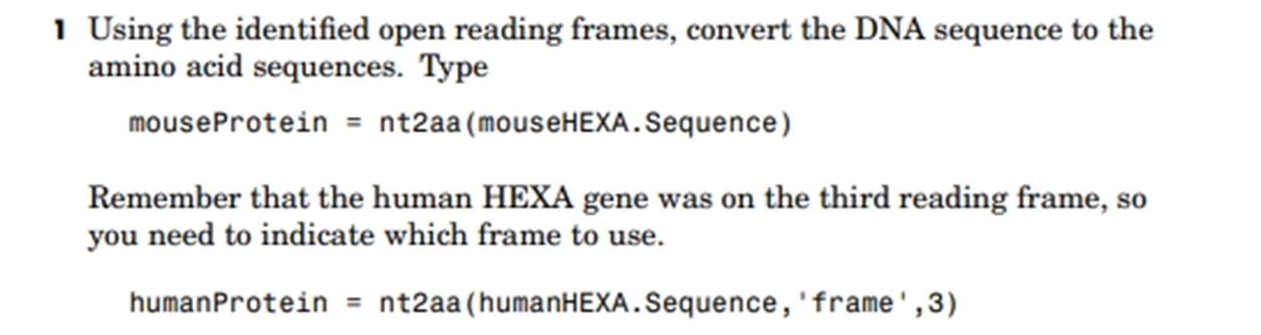
nt2aa

Slide 24
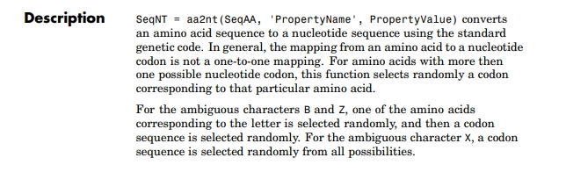
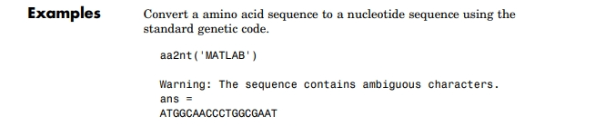
aa2nt

Slide 25
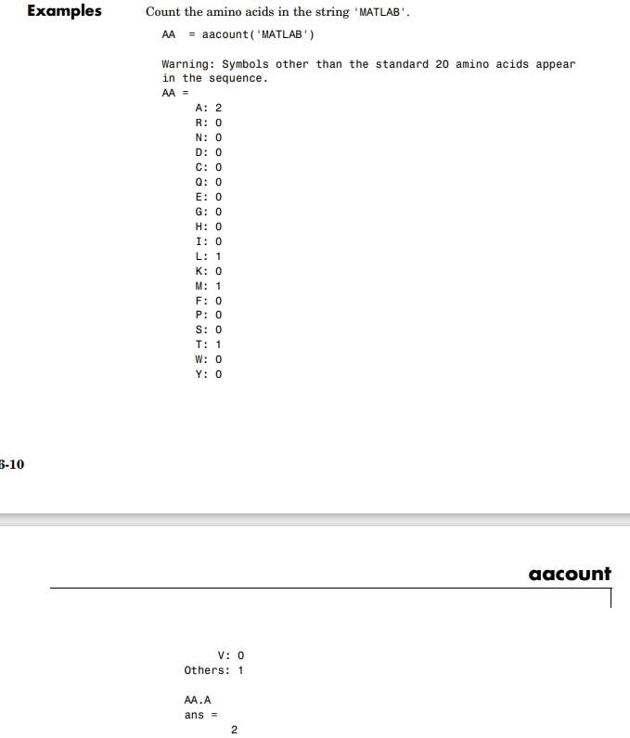
aacount

Slide 26

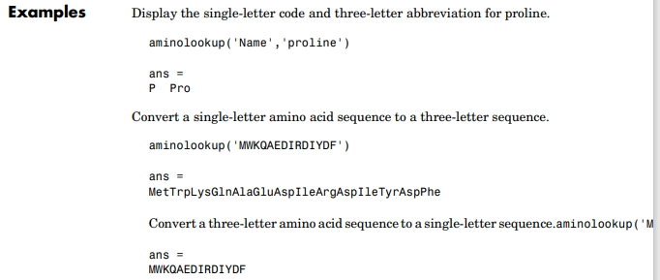
aminolookup

Slide 27
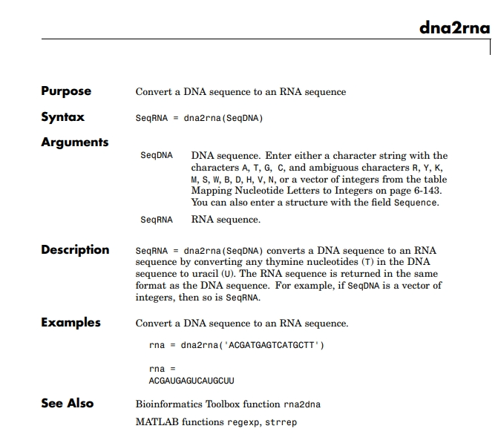
dna2rna

Slide 28
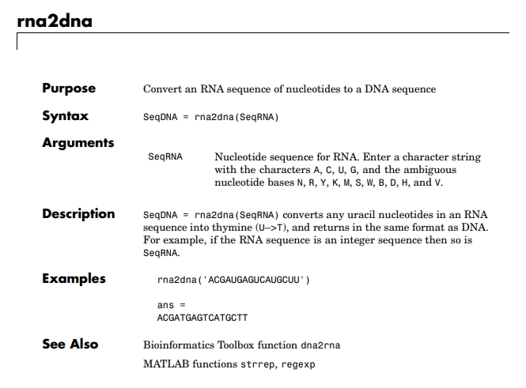
rna2dna

Slide 29
Sequence Analysis
Sequence analysis is the process you use to find information about a nucleotide or amino acid sequence using computational methods.
Common tasks in sequence analysis are -
(a) identifying genes
(b) determining the similarity of two genes
(c) determining the protein coded by a gene, and
(d) determining the function of a gene by finding a similar gene in another organism with a know function.

Slide 30
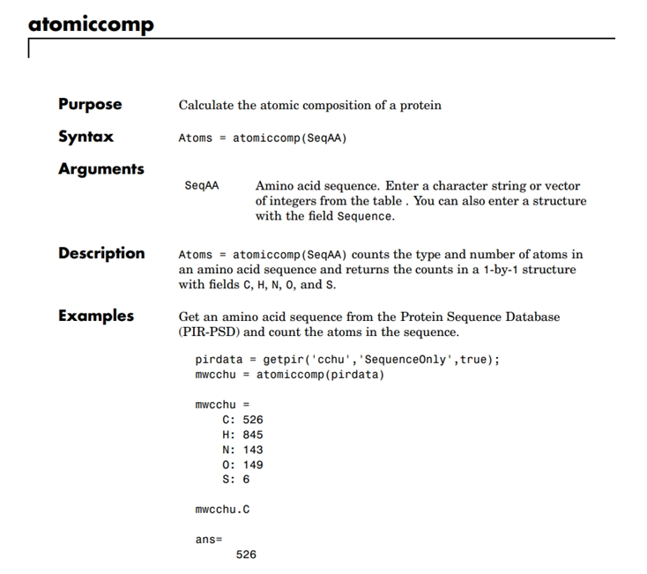
Atomic Composition of a Protein

Slide 31
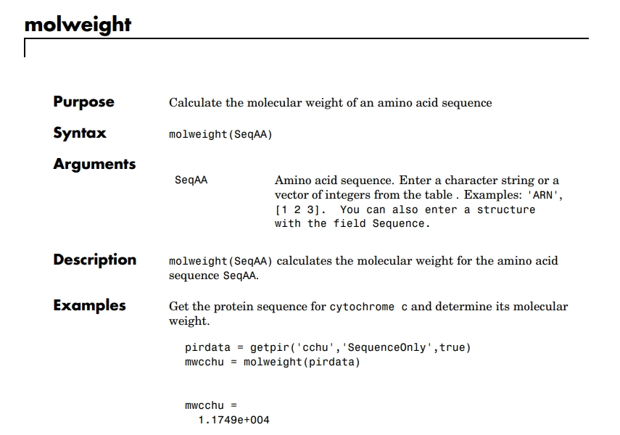
Molecular Weight of an Amino Acid Sequence

Slide 32
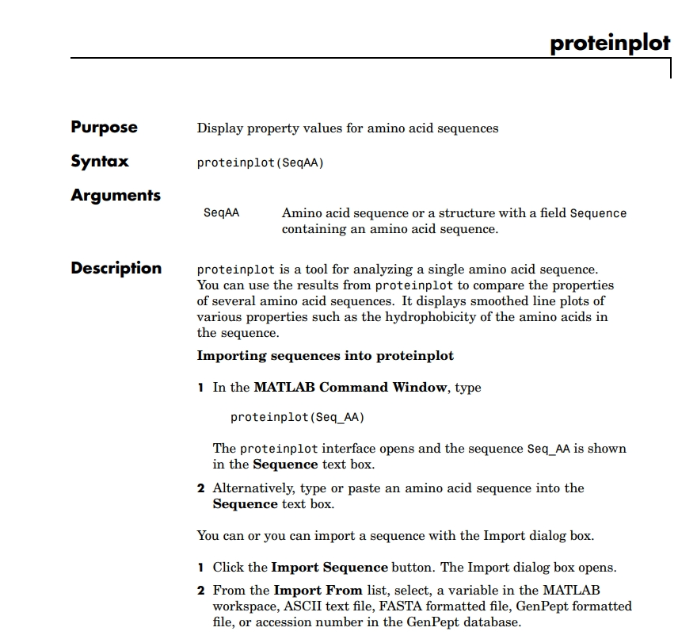
Protein Properties

Slide 33
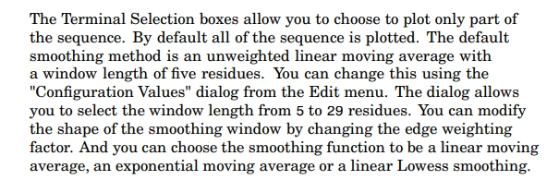
Protein Properties

Slide 34
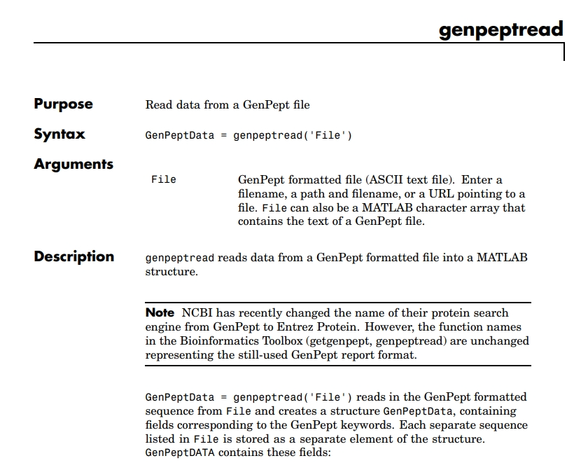
Reading a Protein Data

Slide 35
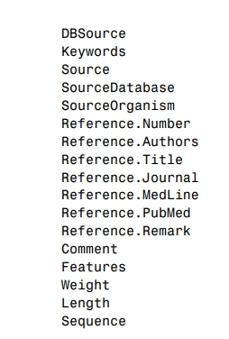
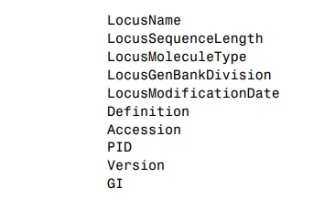
GenPeptDATA contains these fields:

Slide 36
EXAMPLE
Examples Get sequence information for the protein coded by the gene HEXA, save to a file, and then read back into MATLAB.
getgenpept('p06865', 'ToFile', 'TaySachs_Protein.txt')
genpeptread('TaySachs_Protein.txt')

Slide 37
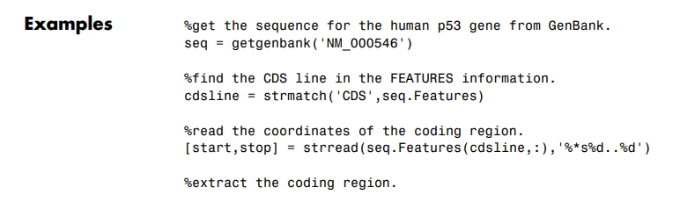
Write to a file using FASTA format
fastawrite('File', Data) writes the contents of Data to a file with a FASTA format
.
codingSeq = seq.Sequence(start:stop)
%write just the coding region to a FASTA file. fastawrite('p53coding.txt','Coding region for p53',codingSeq);

Slide 38
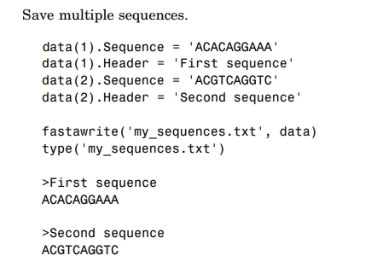
fastawrite('File', Header, Sequence) writes header and sequence information to a file with a FASTA format

Slide 39
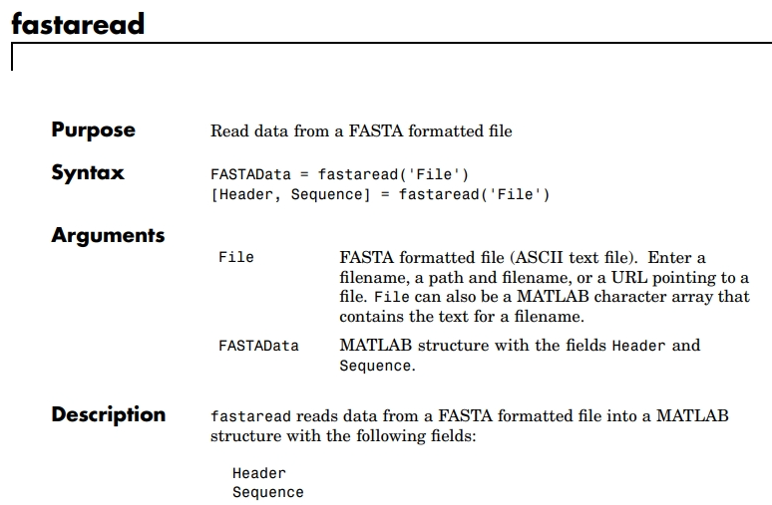
fastaread

Slide 40
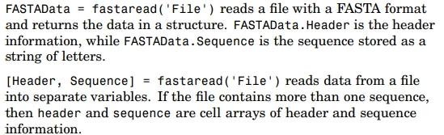
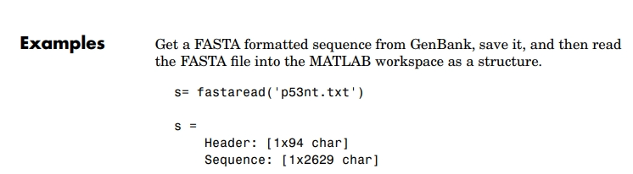

Slide 41
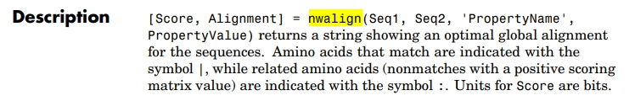
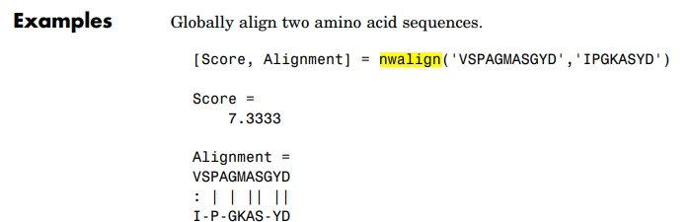
Globally align two sequences using the Needleman-Wunsch algorithm

Slide 42
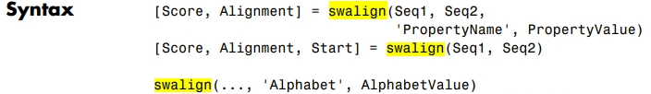
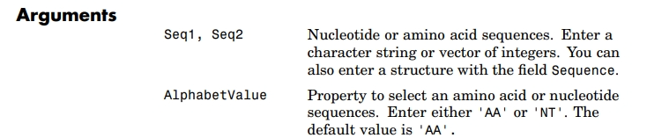
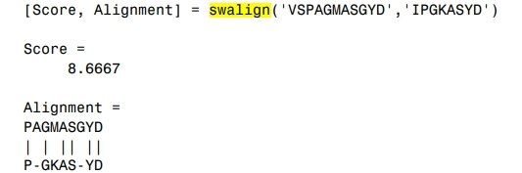
Locally align two sequences using the Smith-Waterman algorithm

Slide 43
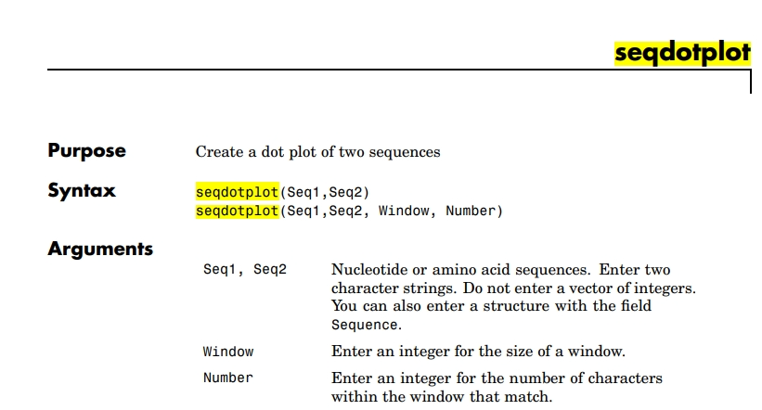
seqdotplot

Slide 44
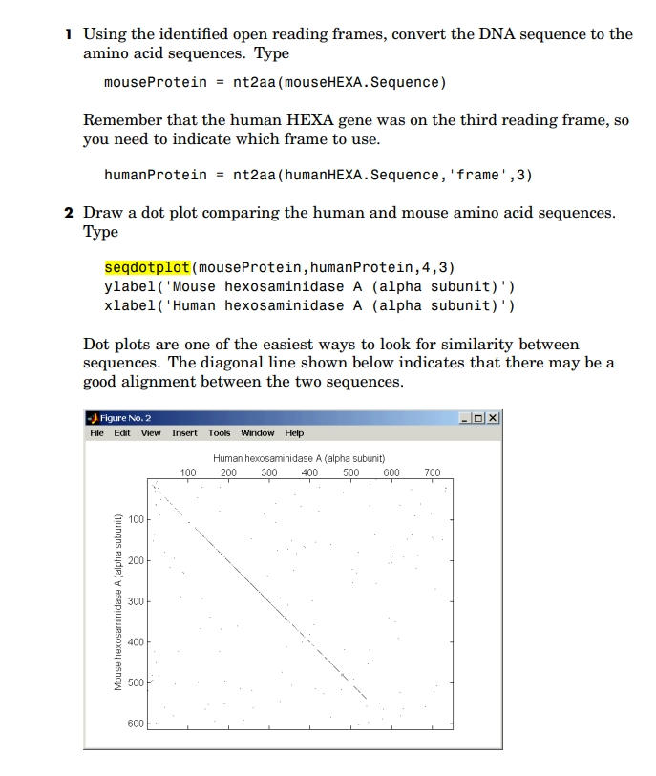
load hexosaminidase
humanORFs=seqshoworfs(humanHEXA.Sequence)
mouseORFs = seqshoworfs(mouseHEXA.Sequence)

Slide 45
